Slide 1

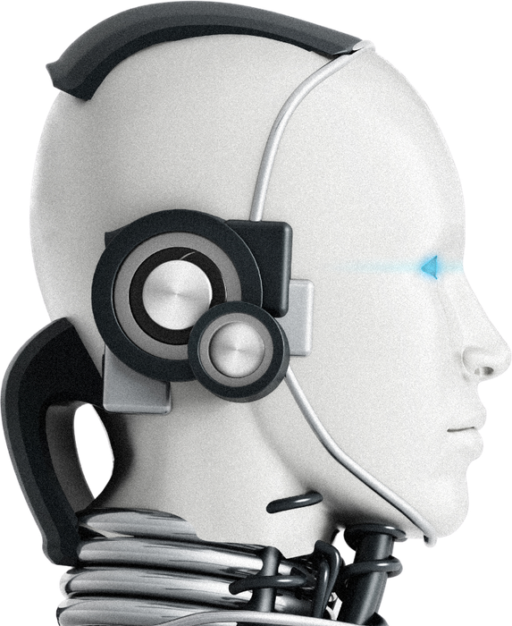


Langchain
Lovedeep
Prachi
Preetham

Slide 2



Table of Contents
Introduction to Langchain
Components of Langchain
Models
Prompts
Structured Output
Parsers
Chains in Langchain
Runnables

Slide 3
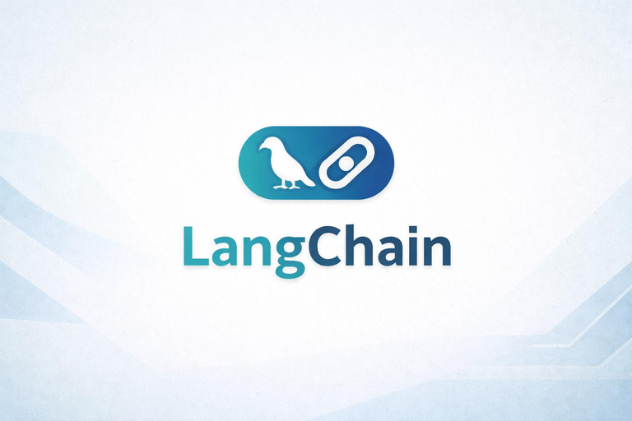
What is Langchain ?
A framework used for building LLM based applications, provides end to end tools that help developers build complex AI applications.
Why Langchain over other Frameworks ?
Langchain provides ready-made components(chains , memory , retrievers), don’t need to build everything from scratch.
Langchain connects seamlessly with API’s, vector stores, and models, making real world AI applications easier to build.
Compared to other frameworks, Langchain enables multi-step logic(chains,agents,RAG), allowing you to create scalable and structured AI systems.

Slide 4
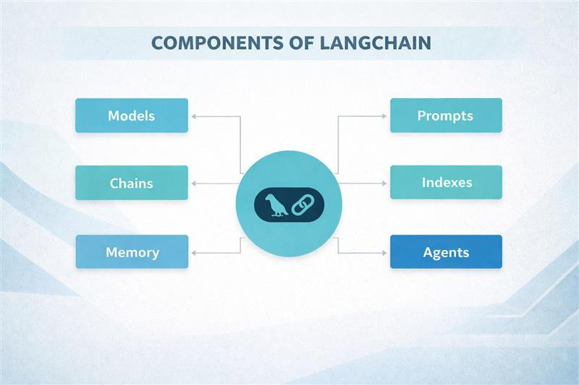

Slide 5
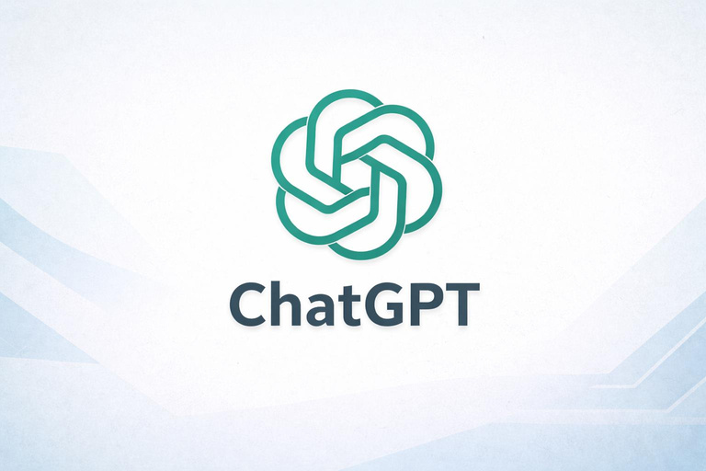
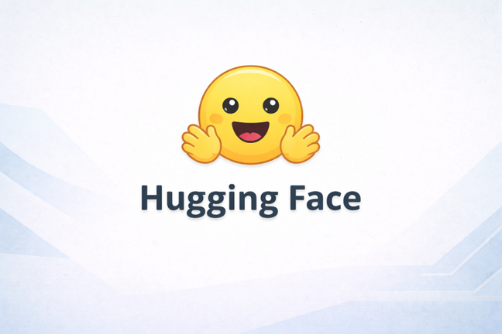
Models
Models are the core components that generate outputs like text, embeddings, or responses by interacting with language models. They act as the brain of the application, taking input prompts and producing outputs like answers, summaries, or embeddings.
Models handle natural language understanding and generation and can be integrated from different providers(Open AI, Hugging Face..) for flexible AI development.
Types of models:
LLMs (Large Language Models)
Chat Models
Embedding models

Slide 6
Chat Models
Embedding Models
Language Models
Designed for conversational interactions using messages.
Maintain context across multiple turns in a conversation.
Accept message based input(user, system, roles).
Generate dialogue style responses.
Used in applications like Virtual assistants and Q&A systems.
Convert text into numerical vectors.
Used for similarity search and semantic understanding.
Help in retrieval tasks(RAG).
Enable clustering and recommendation.
Work with vector databases for fast lookup.
Work on plain text input and output.
Best for tasks like text generation, summarization and completion.
Produce content aware outputs based on input sequence.
Trained on large scale datasets.
Support multiple languages.

Slide 7


Prompts
A simple input, instruction or command you give to AI to make it understand what you want.
What are Prompt Templates?
Predefined structured prompts with placeholders. Allow dynamic input with certain benefits:
By default validation
Reusability
Maintainability
Example: "Summarize the following text in {tone} tone: {text}”

Slide 8
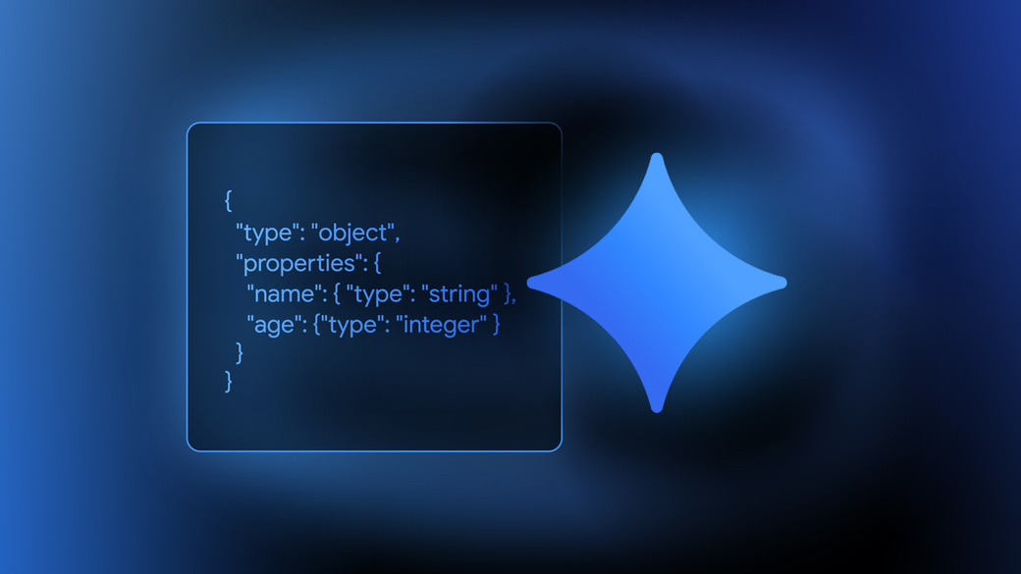
Structured Output
Converts LLM raw text output into a structured format
Why ?
LLM output are Unstructred.
Application need machine-readable data
Text response hard to process.
Make automation possible.
How ?
TypedDict
Pydantic
Json Schema
Output Parser (Used with LLMs which don’t support structured Output.)

Slide 9
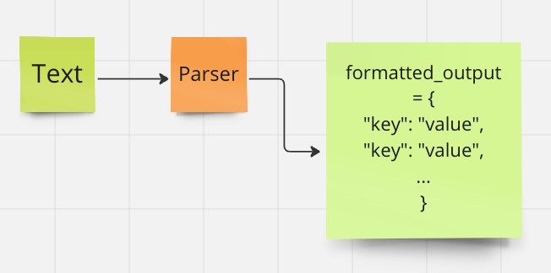
TypedDict
Benefits:
Defines expected Key-value types.
Generally used when whole project is in python.
Limitations:
No runtime Validation
Pydantic
Benefits:
Strict data validation
Automatic error handling
Converts output into python objects
Limitations:
Fails on bad output
JSON Schema
Benefits:
Standardized format
Cross Language compatible
Limitations:
Large schema become complex

Slide 10
Output Parsers
String output parser
Benefits:
Simple and fastest
Good for summaries, chat replies
Limitations:
No structure or Validation
Structured Output Parser
Benefits:
Enforce predefined Structure
Reduce ambiguity in response
Limitations:
LLM may still violate structure
Limited type validation
Json Output parser
Benefits:
Machine readable format
Easy integration with APIs
Limitations:
Requires prompt discipline
LLM may produce invalid JSON
Pydantic Output parser
Benefits:
Strong type validation
Automatic error detection
Limitations:
Less flexible for free-text output

Slide 11

Chains
and
Runnables

Slide 12
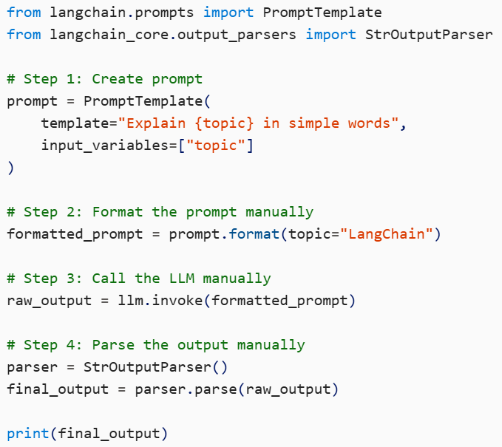
Why Do We Need Chains?
The Problem Statement
Before Chains:
Prompts, models, and parsers worked independently
Manual orchestration required
Repetitive glue code in applications
Need for Chains:
Combine multiple steps into one workflow
Ensure sequential execution
Improve reusability and readability

Slide 13
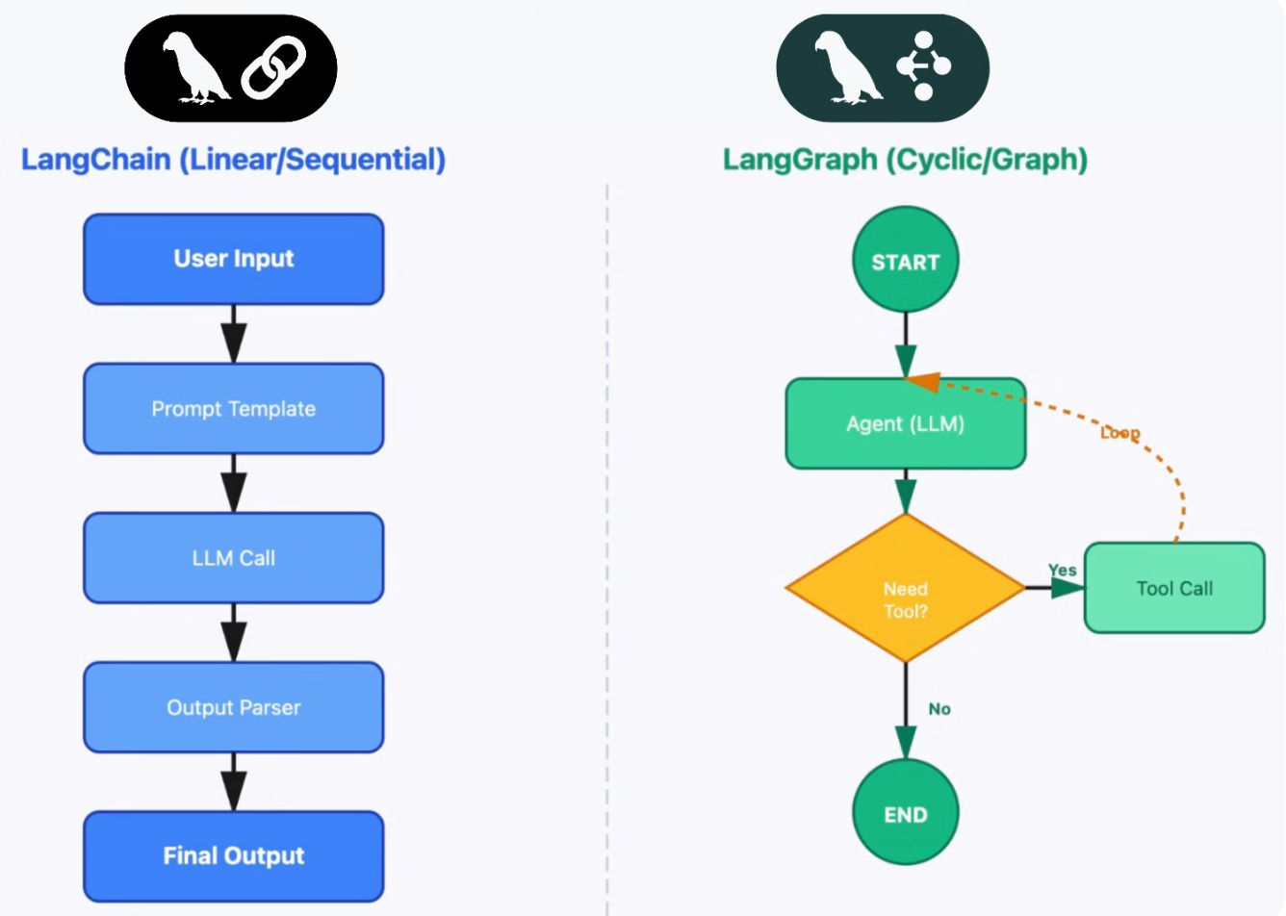
What Are Chains in LangChain?
A Chain is a sequence of components where the output of one step becomes the input of the next.
Key Characteristics:
Linear workflow
Easy to understand
Combines prompts, models, parsers, tools

Slide 14
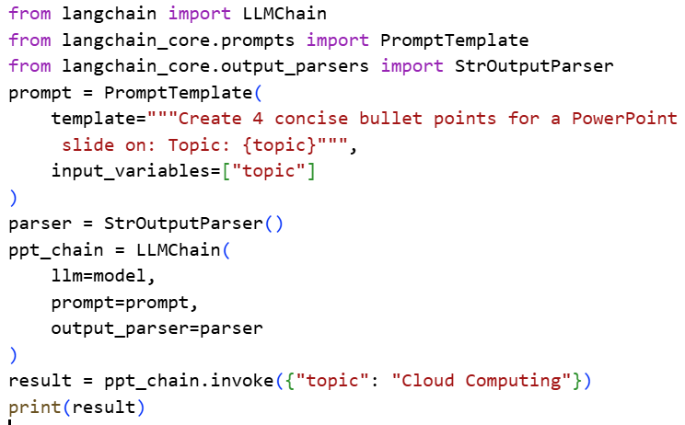
Traditional Chains
Traditional chains were created using predefined or custom chain classes that manually connected components with different call methods.
Examples: LLMChain, SequentialChain etc.
Problems:
No common execution interface across
components
Required custom chain classes for every
workflow
Made the codebase heavy and complex
Difficult for users to learn and extend

Slide 15
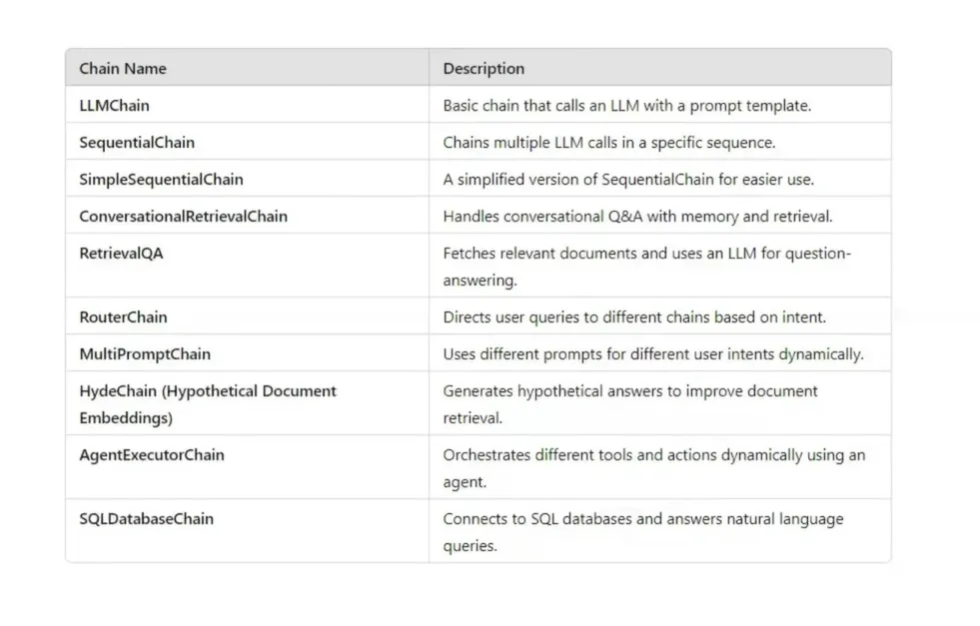

Slide 16
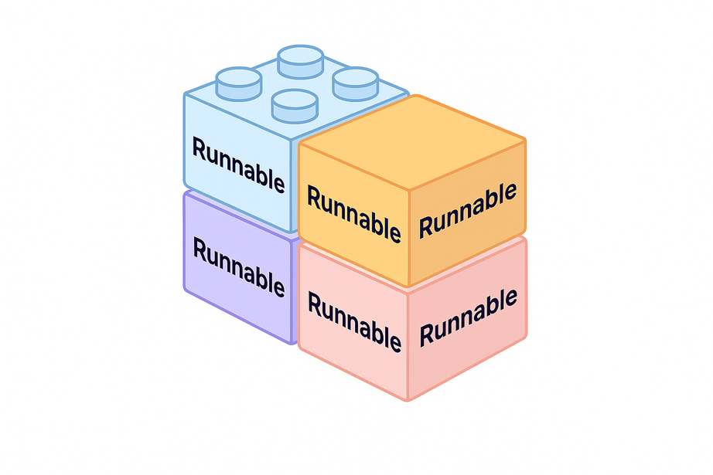
Runnables
A Runnable is a unit of work in LangChain.
Every runnable:
Takes some input.
Processes the input.
Returns an output.
All runnables follow a common interface with standardized methods, such as:
invoke(input): Process input and return output.
batch(inputs): Process multiple inputs at once, returning multiple outputs.
stream(): Support streaming outputs.

Slide 17
Task‑Specific Runnables
Runnable Primitives
Core LangChain components converted into Runnables
Each Runnable performs a specific
task
Used to build functional pipelines
Examples:
PromptTemplate – designs prompts
ChatOpenAI / LLM – interacts with models
Retriever – fetches documents
Fundamental building blocks for execution logic
Control how runnables interact
Enable sequencing, parallelism, and conditional flows
Examples:
RunnableSequence
RunnableParallel
RunnablePassthrough

Slide 18


